Slide 1
Smart Sleep Monitor and Analyzer
Final Report
Qing Li

Slide 2
Project Objectives
Design a small and beautifully covered sleep monitor to analyze user’s sleep quality
Detect user’s movements
Analyze sleeping periods
Track user’s sleep quality

Slide 3
Design Schema
Sound Sensor
Arduino Nano
Accelerometer
Power Bank
PC

Slide 4
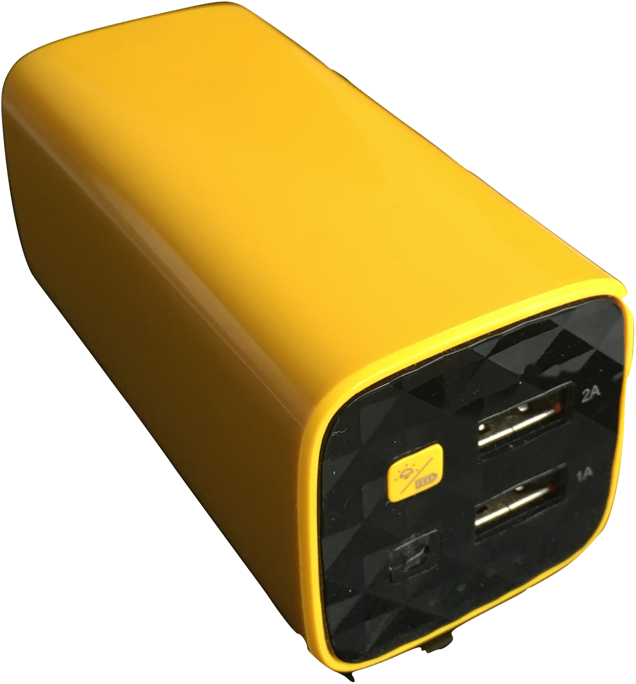
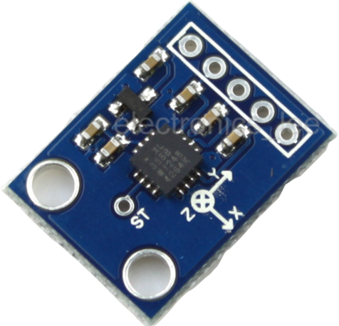
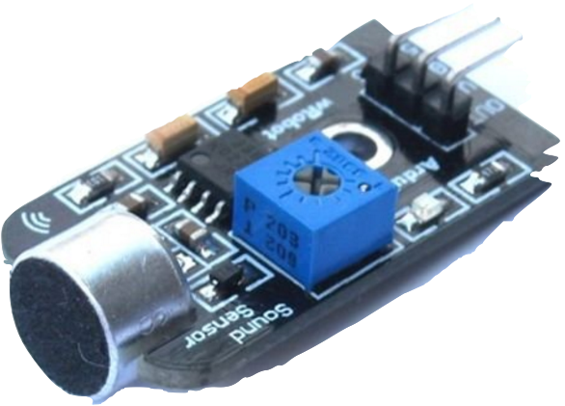
Components

Slide 5
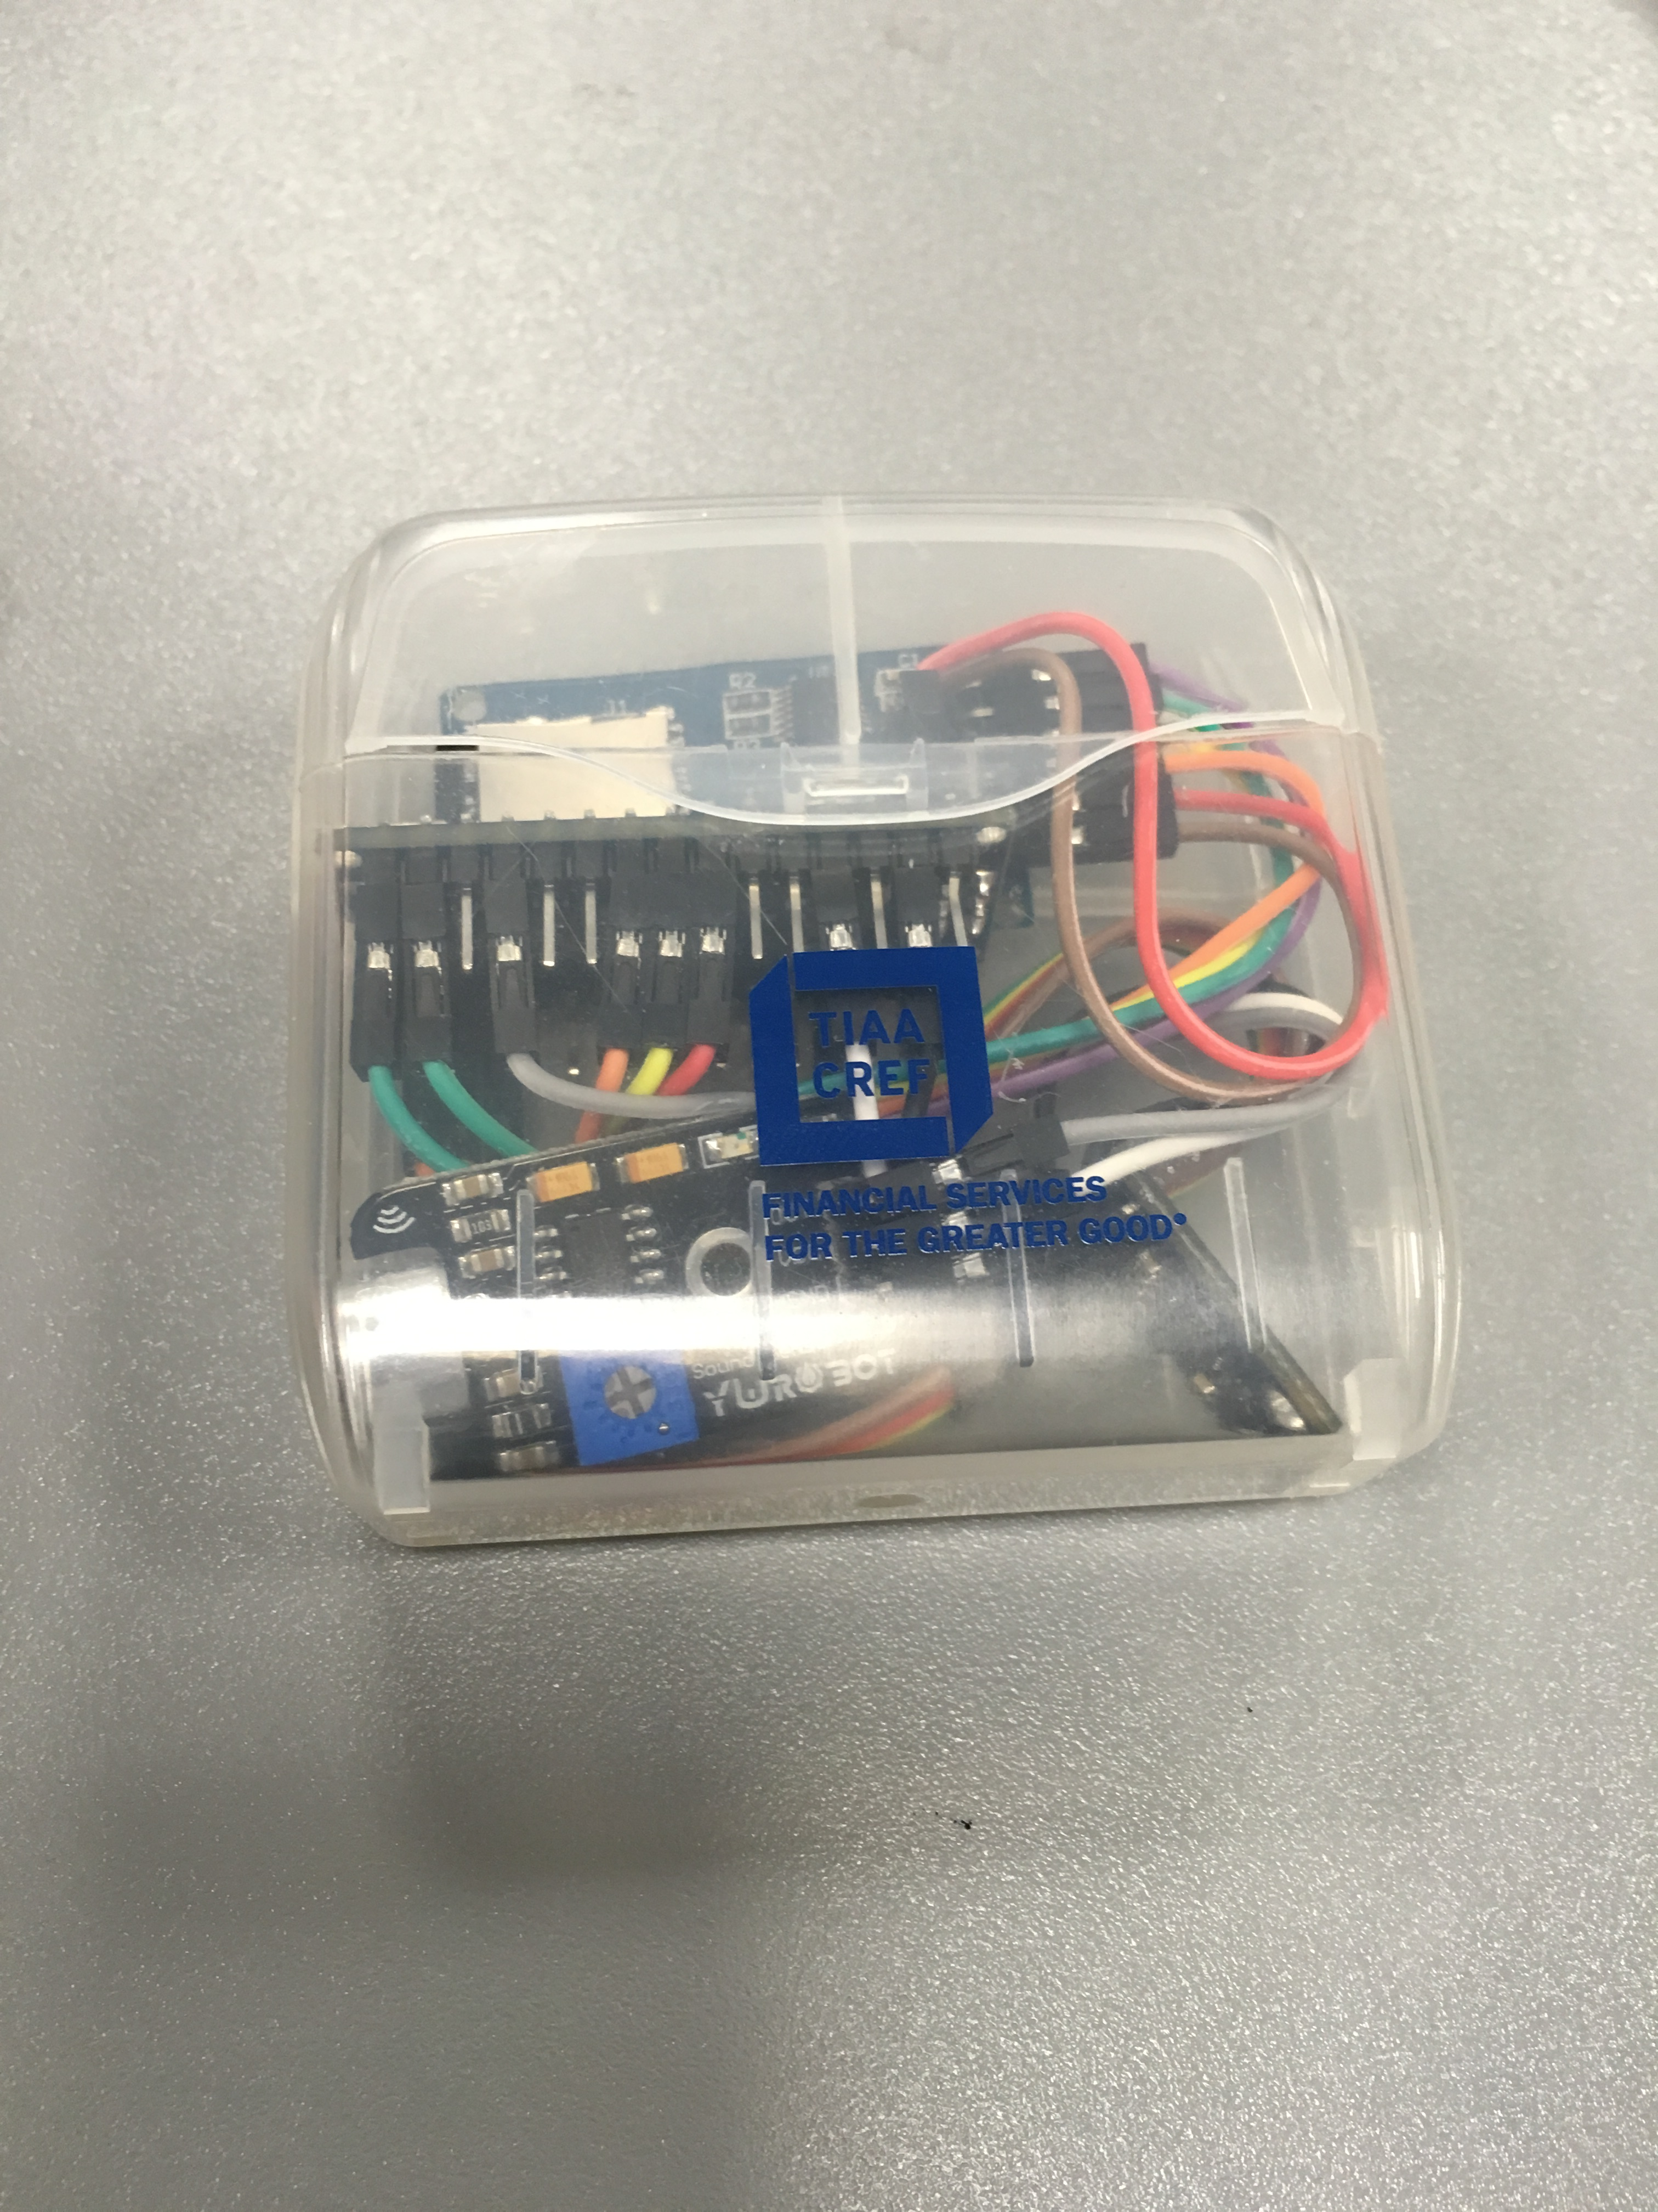
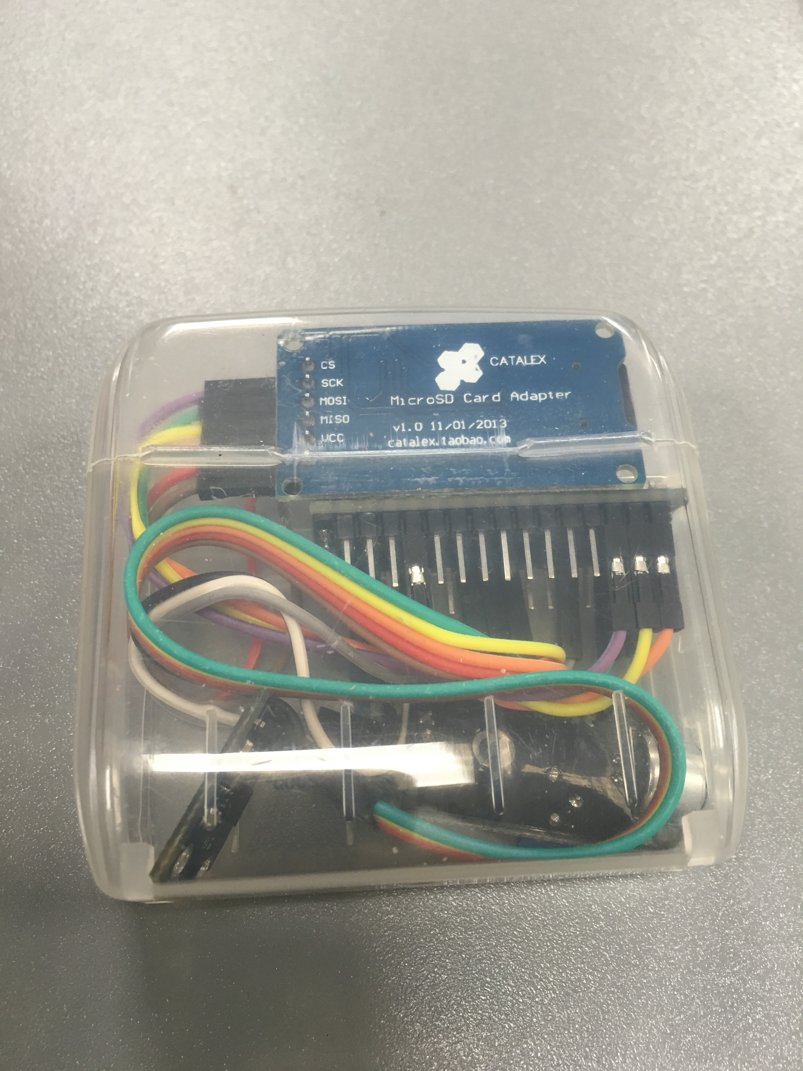
Components

Slide 6
Progress
Before: use Bluetooth module to communicate with computer
Advantages: real-time analyzing, big storage
Shortcomings: signal noise, connection interruption
After: use on-board EEPROM to store data
Advantages: no noise, no connection problem
Shortcomings: limited memory space, only 1KB storage
Finally: use micro SD module to store data
Advantages: no noise and no storage limitation

Slide 7
Progress
Store data in a flash memory array
Array length: 240 Type: byte
Sample rate: 240/min
Differential signal: d(t) = x(t) – x(t-1) + y(t) – y(t-1) + z(t) – z(t-1)
0 | 1 | 2 | 3 | 4 | 5 | … | 237 | 238 | 239
9 | 0 | 12 | 1 | 2 | 27 | … | 2 | 2 | 9
1 minute data

Slide 8
Progress
Store the one minute data into micro SD card
Write them in a text file
1 | 2 | 3 | 4 | 5 | 6 | … | i | i+1 | i+2 | …
amp | hour | min | amp | hour | min |  | end |  |  | …
Data in EEPROM

Slide 9
Analysis
After gathering sleep data:
Plug in this device to the computer
Run MATLAB code to generate sleep periods from the data
Write the result into another text file
Run Tableau to visualize the data
Github -> https://github.com/li1993qing1993/Arduino-Sleep-Monitor

Slide 10
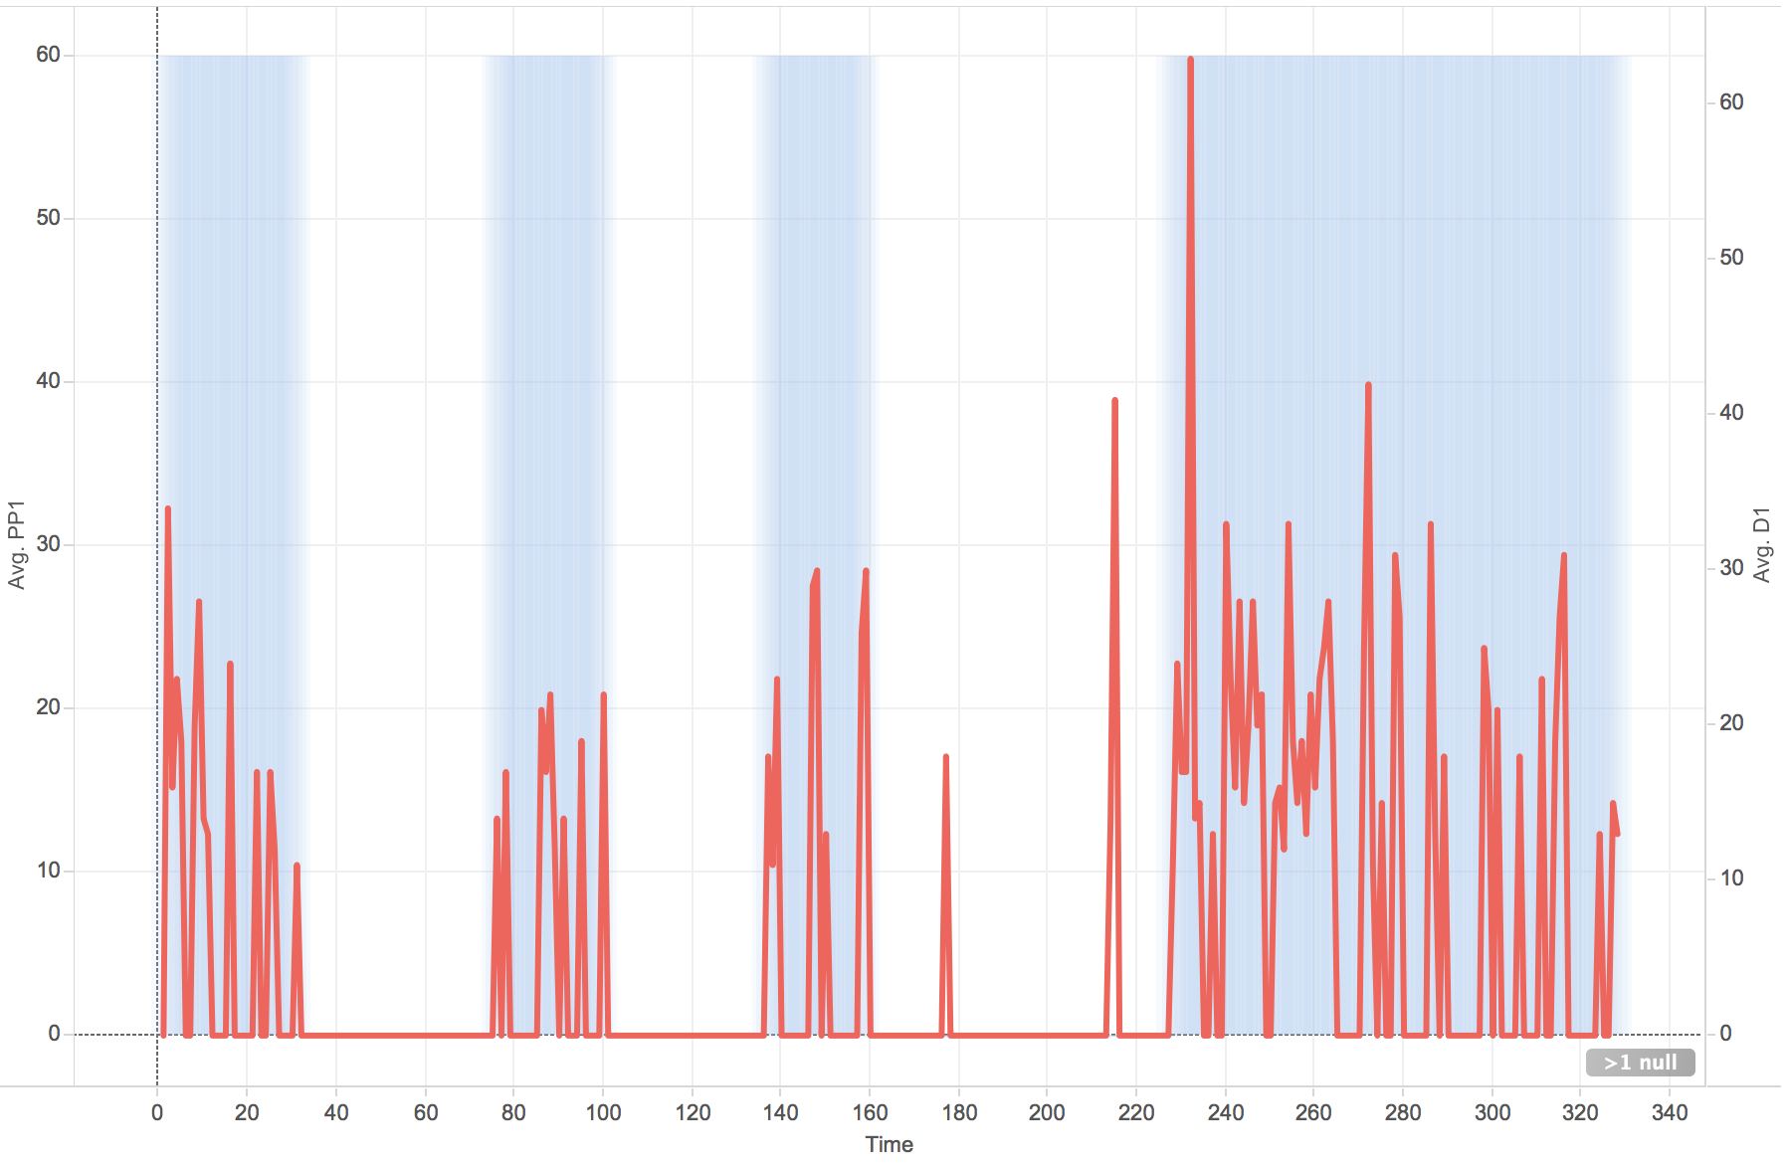
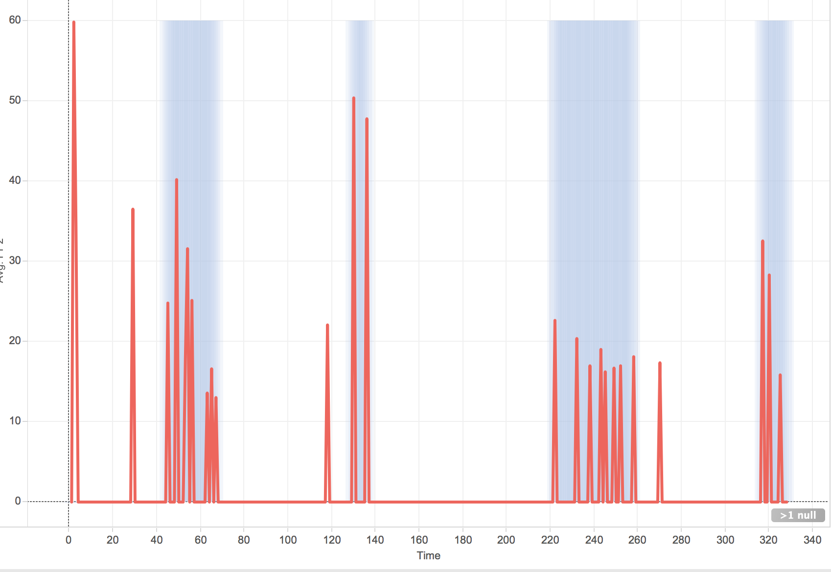


Analysis

Slide 11
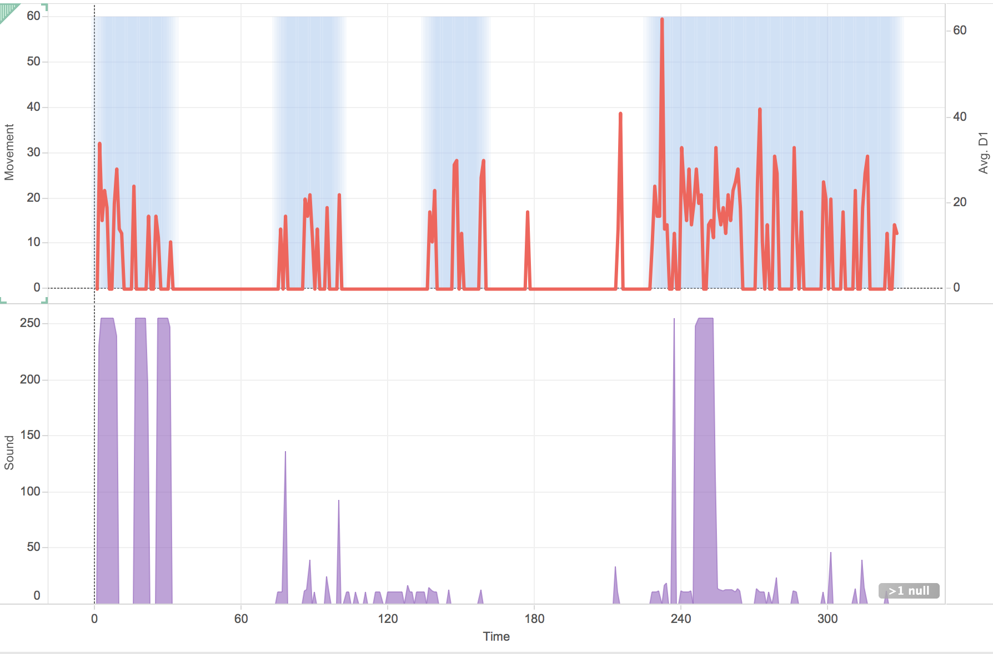
Analysis
And I also added sound sensor to my Arduino Nano. Now the sleep monitor can also get sound data.

Slide 12
Future tasks
Analyze data in different situations such as in cold or hot temperature
Visually analyze the data
Integrate network function to this device
Integrate multiple analyzing tools instead of working on separate software (MATLAB and Tableau)
Upload data to the cloud and share data from multiple users

